Slide 1
Sprint Review 2: Shark Frenzy
Kristyn Raleigh, Morgan Jones, Brian Thompson, Scott Johnson

Slide 2
New Feature Mockups
Calendar
Group Pages
Find Group Members
Create Profile

Slide 3
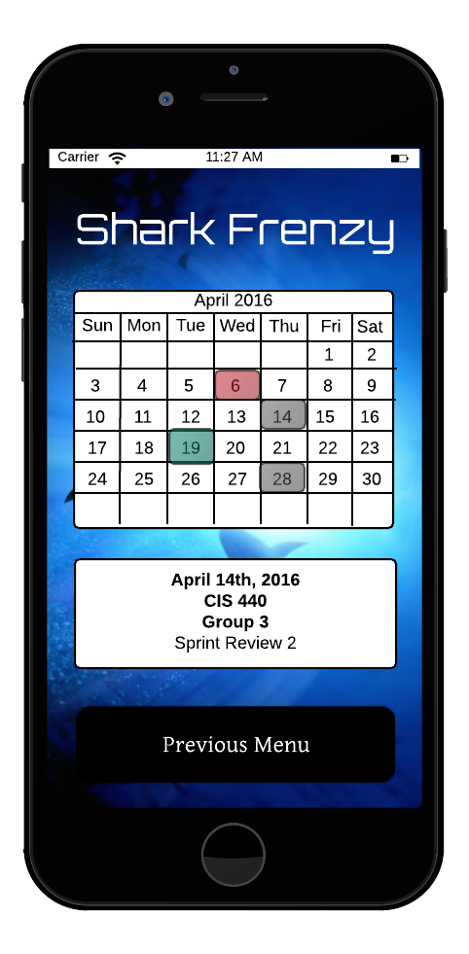
Calendar Mockup

Slide 4
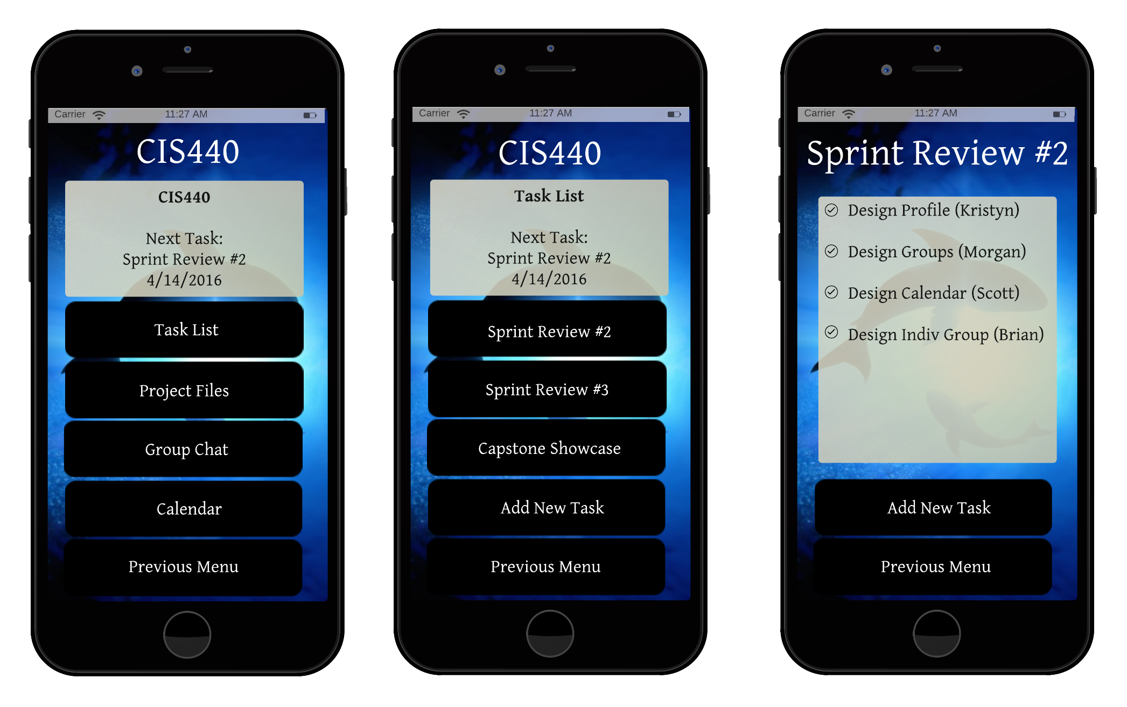
Group Pages

Slide 5
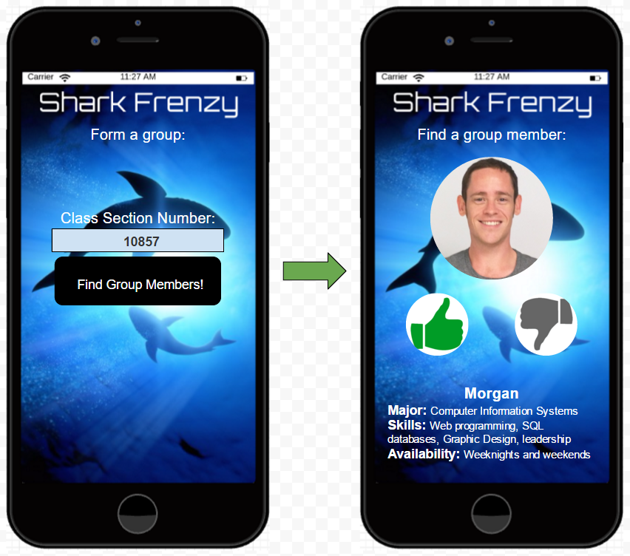
Find Group Members

Slide 6
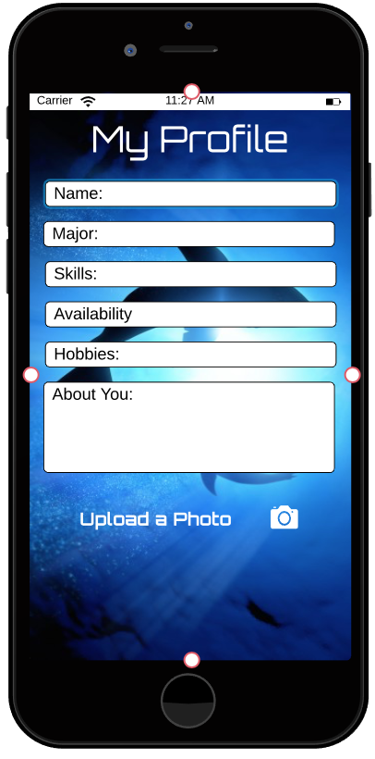
Edit User Profile

Slide 7
Survey Findings
30 total respondents
43% of respondents said they would use the chat feature of the app
20% of respondents said they don’t understand the name of the app 43% said they didn’t hate it
The design wasn’t extremely popular among respondents only 40% liked it, 30% didn’t hate it, & 20% hated it
63.7% of respondents were interested or very interested in the app based on the elevator pitch
76.7% said it was moderate to difficult to find good group members
The most important qualities of a group member to respondents were availability, skills, college major, & picture.
Notes:
Kristyn

Slide 8
User Feedback
“Not a fan of the font at all.”
“Make the backgroud a solid color. The font is aweful.”
“It's functional and organized, but doesn't get me excited about using the app.”
“I know nothing about the organization based on the name.”
“I do not like the font.”
“The font choice makes it gives of virus-y vibes if that makes sense? Would prefer a cleaner, more professional logo and home screen.”
“Change the font, it looks like a game or some shitty 80s movie”
Notes:
Kristyn

Slide 9
User Feedback
Facebook Page Likes: 0
I have an Idea that Rocks Likes: 1 (Same as last week)
Notes:
Kristyn

Slide 10
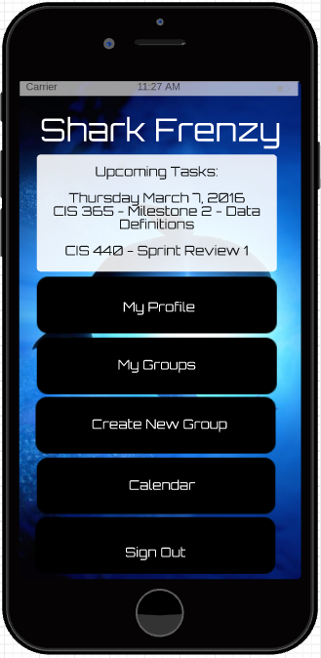
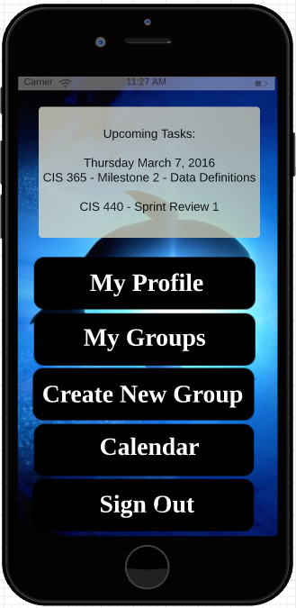
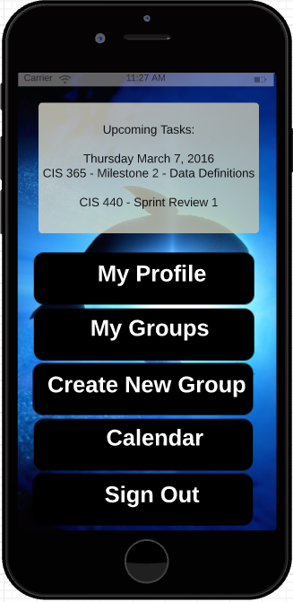
Live User Feedback
A
B
C

Slide 11
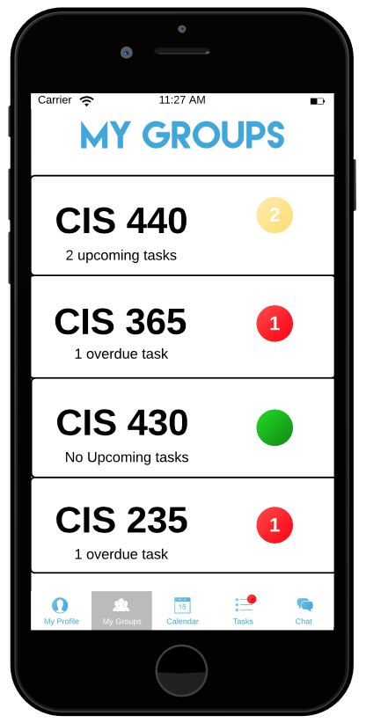
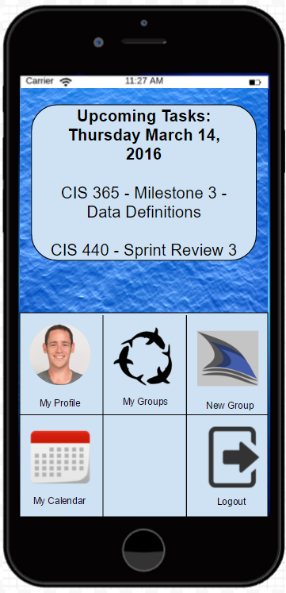
Live User Feedback 2
A
B
C

Slide 12
Next Sprint
Name Change or add slogan?
Logo Change?
A/B UI testing

Slide 13
Questions?

